Slide 1
Robust Decision Making e Modelagem Exploratória para Análise de Decisões Estratégicas
Pedro Nascimento de Lima
Programa de Pós Graduação em Engenharia de Produção e Sistemas - Unisinos

Slide 2
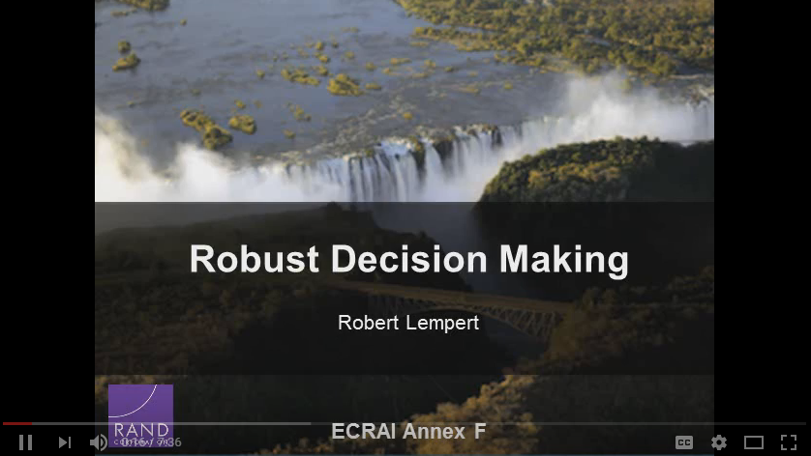
Robust Decision Making - Conceptual
https://www.youtube.com/watch?v=TsYY3FCCBkU

Slide 3
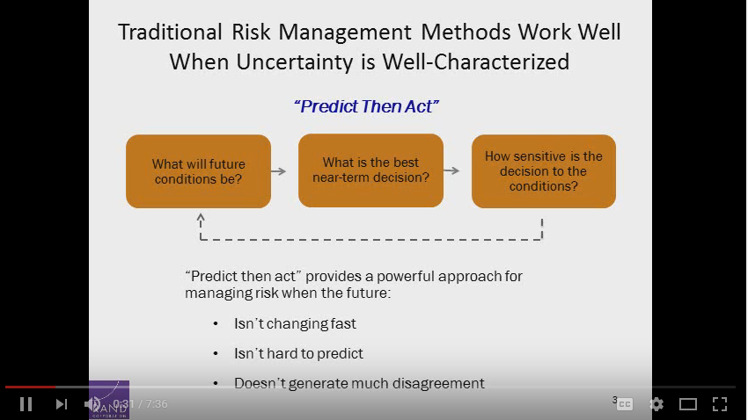
Robust Decision Making - Conceptual
https://www.youtube.com/watch?v=TsYY3FCCBkU

Slide 4
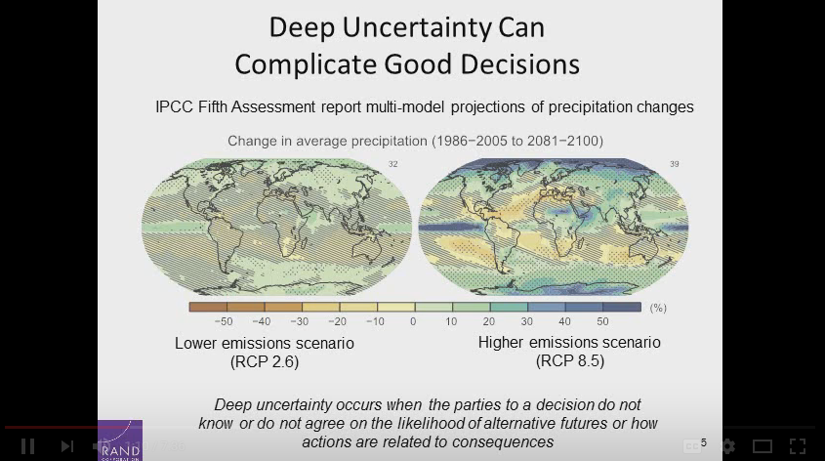
Robust Decision Making - Conceptual
https://www.youtube.com/watch?v=TsYY3FCCBkU

Slide 5
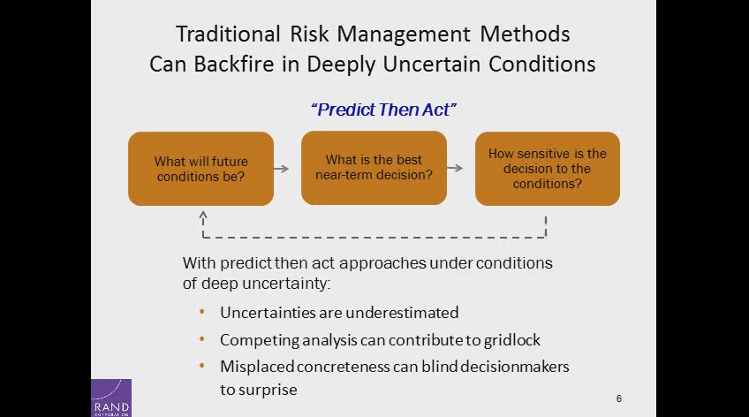
Robust Decision Making - Conceptual
https://www.youtube.com/watch?v=TsYY3FCCBkU

Slide 6
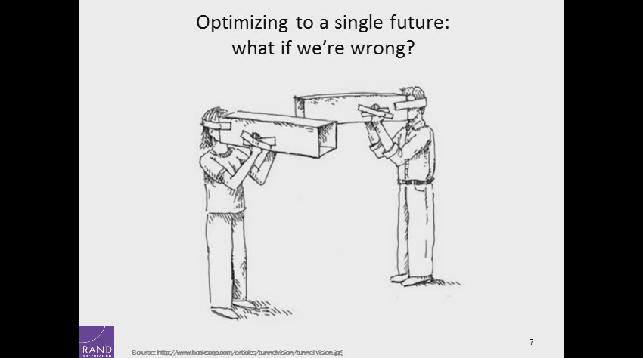
Robust Decision Making - Conceptual
https://www.youtube.com/watch?v=TsYY3FCCBkU

Slide 7
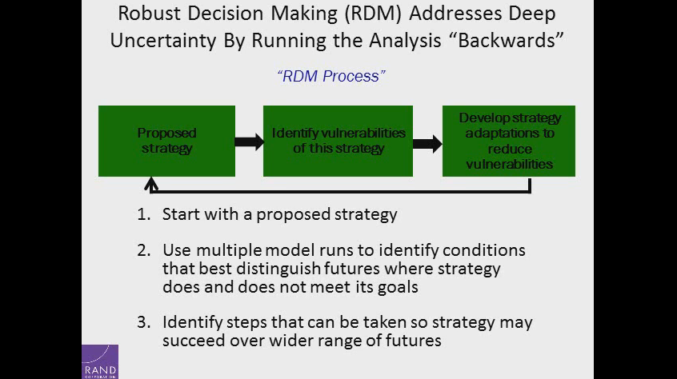
Robust Decision Making - Conceptual
https://www.youtube.com/watch?v=TsYY3FCCBkU

Slide 8
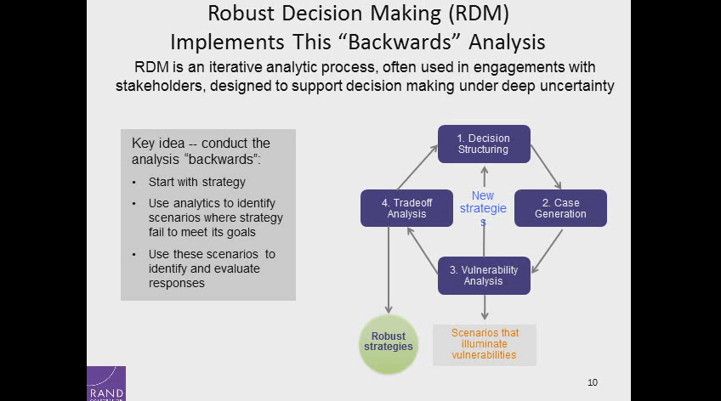
Robust Decision Making - Conceptual
https://www.youtube.com/watch?v=TsYY3FCCBkU

Slide 9
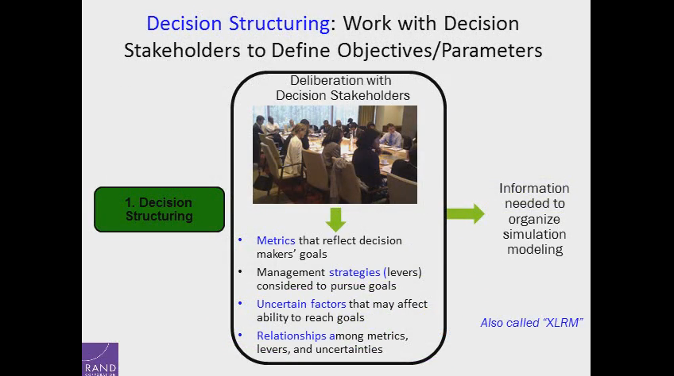
Robust Decision Making - Conceptual
https://www.youtube.com/watch?v=TsYY3FCCBkU

Slide 10
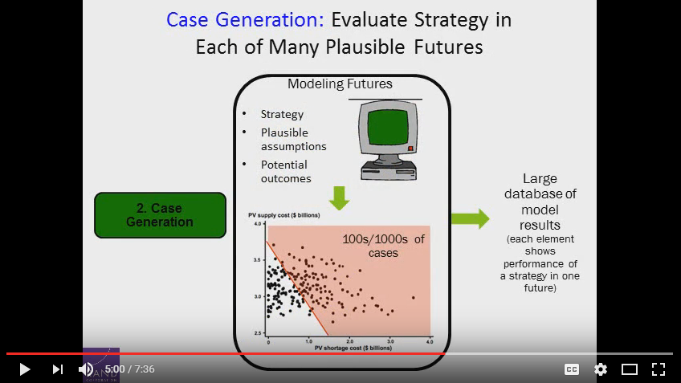
Robust Decision Making - Conceptual
https://www.youtube.com/watch?v=TsYY3FCCBkU

Slide 11
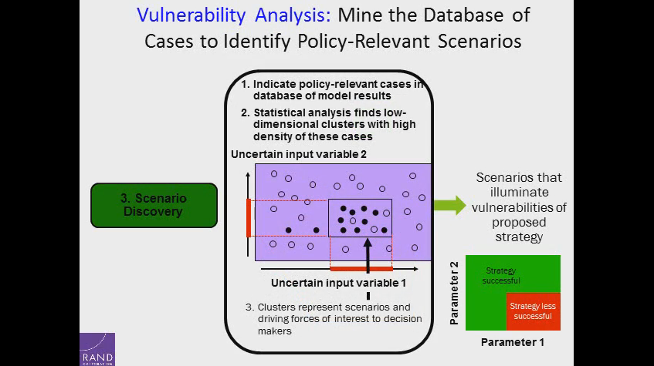
Robust Decision Making - Conceptual
https://www.youtube.com/watch?v=TsYY3FCCBkU

Slide 12
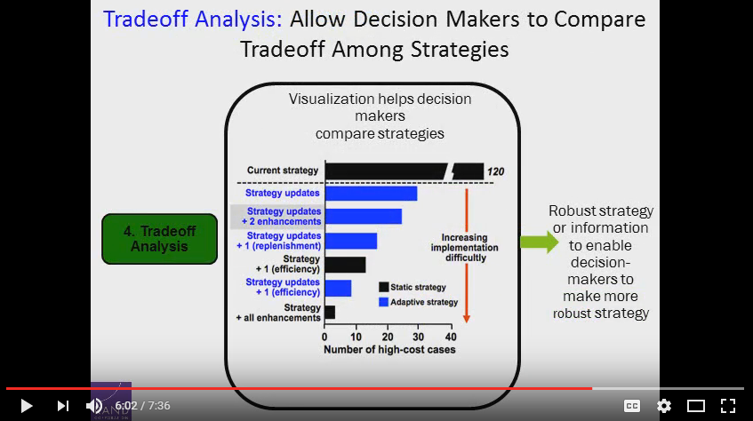
Robust Decision Making - Conceptual
https://www.youtube.com/watch?v=TsYY3FCCBkU

Slide 13
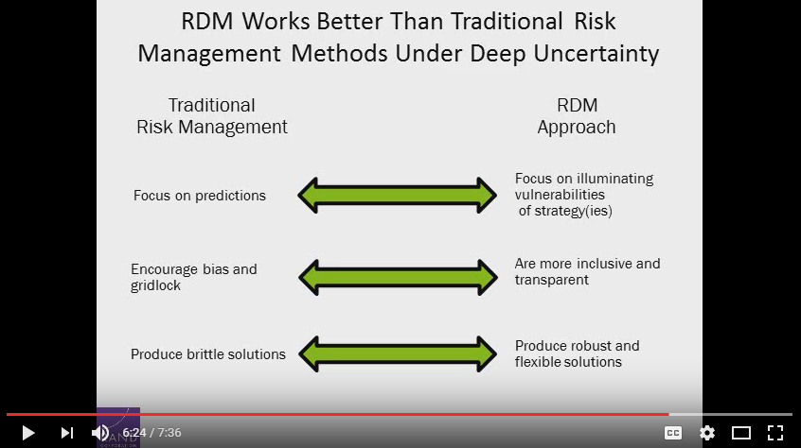
Robust Decision Making - Conceptual
https://www.youtube.com/watch?v=TsYY3FCCBkU

Slide 14
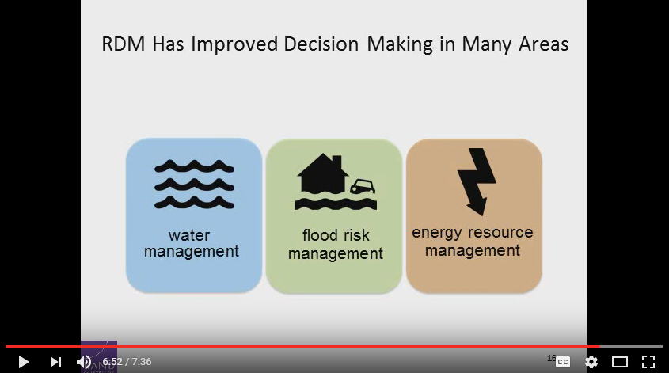
Robust Decision Making - Conceptual
https://www.youtube.com/watch?v=TsYY3FCCBkU

Slide 15
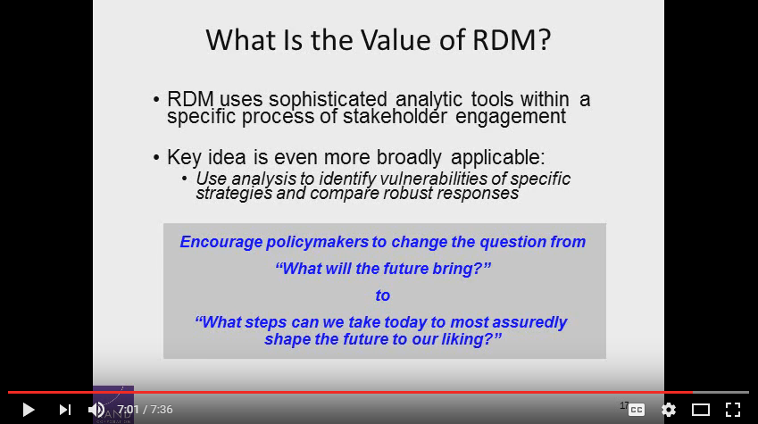
Robust Decision Making - Conceptual
https://www.youtube.com/watch?v=TsYY3FCCBkU

Slide 16
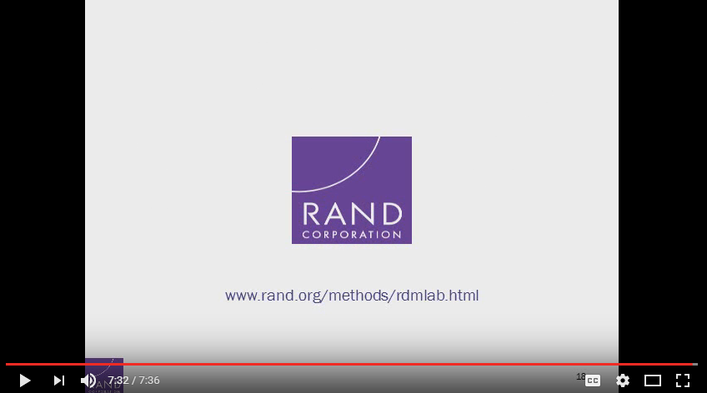
Robust Decision Making - Conceptual
https://www.youtube.com/watch?v=TsYY3FCCBkU

Slide 17
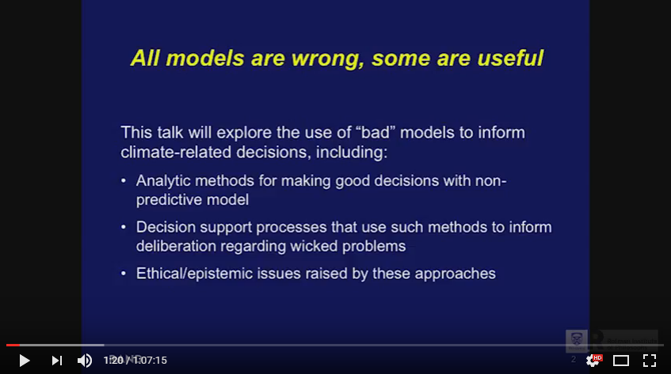
Robert Lempert: Democratizing Analytics: Scientifically and Ethically Informed Decision Support
https://www.youtube.com/watch?v=D01UM0G2m_k

Slide 18
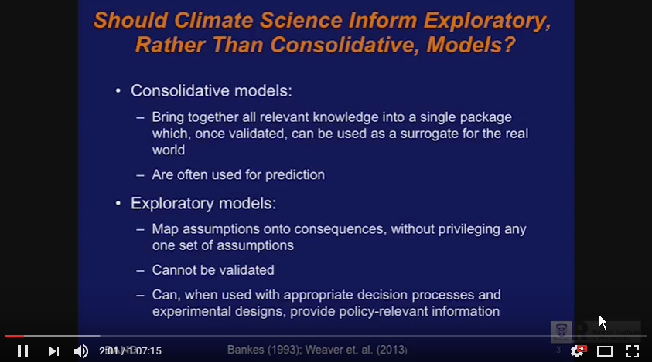
Robert Lempert: Democratizing Analytics: Scientifically and Ethically Informed Decision Support
https://www.youtube.com/watch?v=D01UM0G2m_k

Slide 19
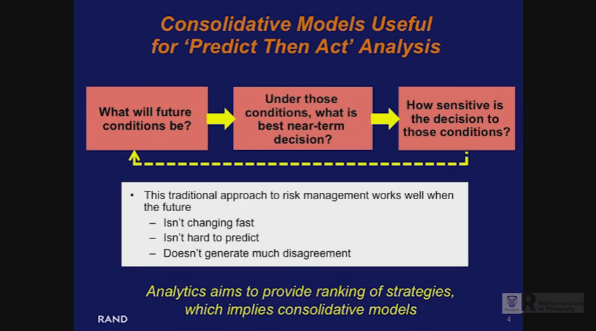
Robert Lempert: Democratizing Analytics: Scientifically and Ethically Informed Decision Support
https://www.youtube.com/watch?v=D01UM0G2m_k

Slide 20
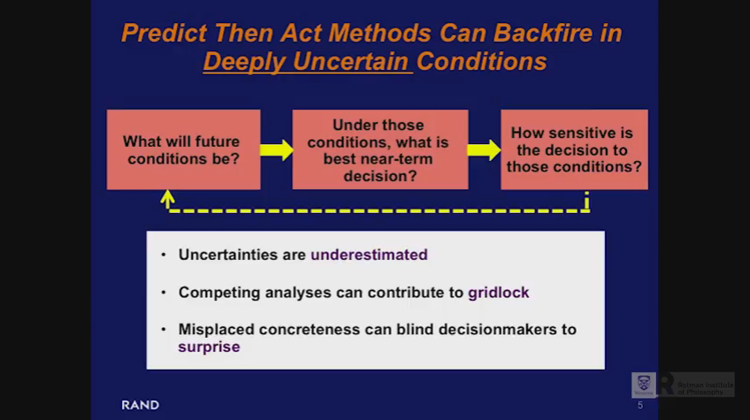
Robert Lempert: Democratizing Analytics: Scientifically and Ethically Informed Decision Support
https://www.youtube.com/watch?v=D01UM0G2m_k

Slide 21
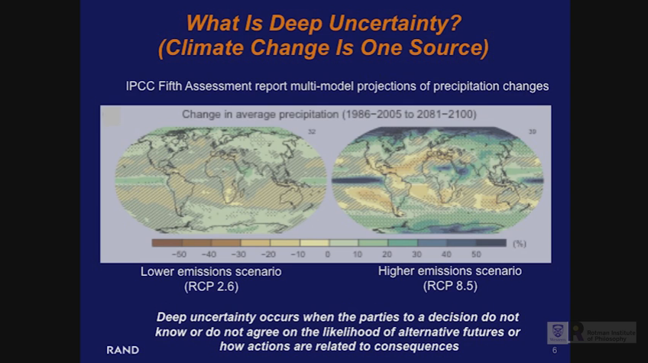
Robert Lempert: Democratizing Analytics: Scientifically and Ethically Informed Decision Support
https://www.youtube.com/watch?v=D01UM0G2m_k

Slide 22
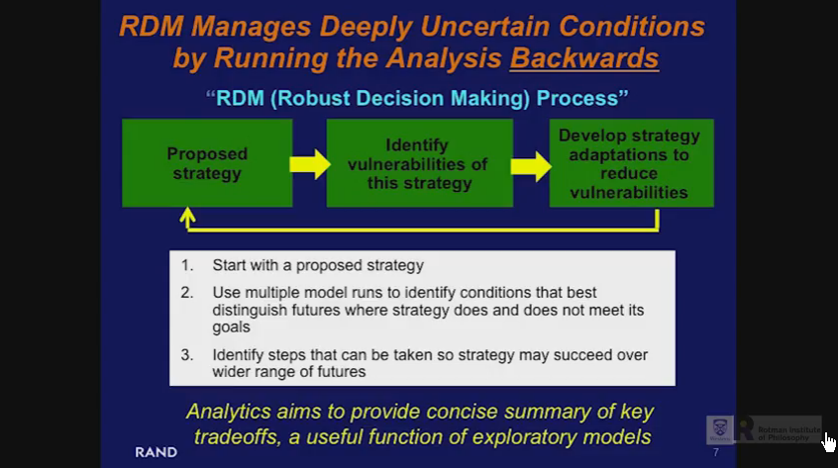
Robert Lempert: Democratizing Analytics: Scientifically and Ethically Informed Decision Support
https://www.youtube.com/watch?v=D01UM0G2m_k

Slide 23
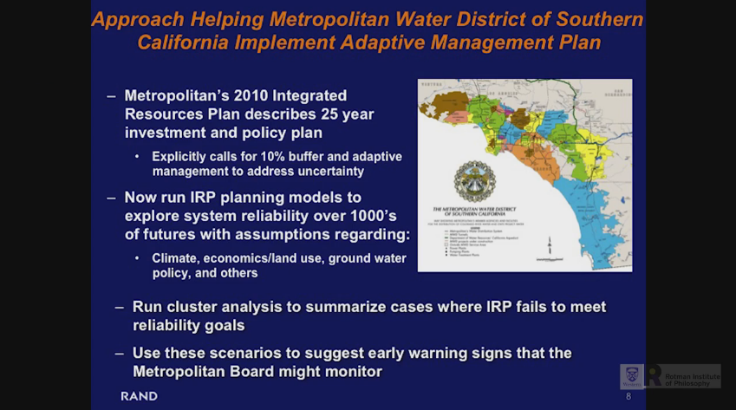
Robert Lempert: Democratizing Analytics: Scientifically and Ethically Informed Decision Support
https://www.youtube.com/watch?v=D01UM0G2m_k

Slide 24
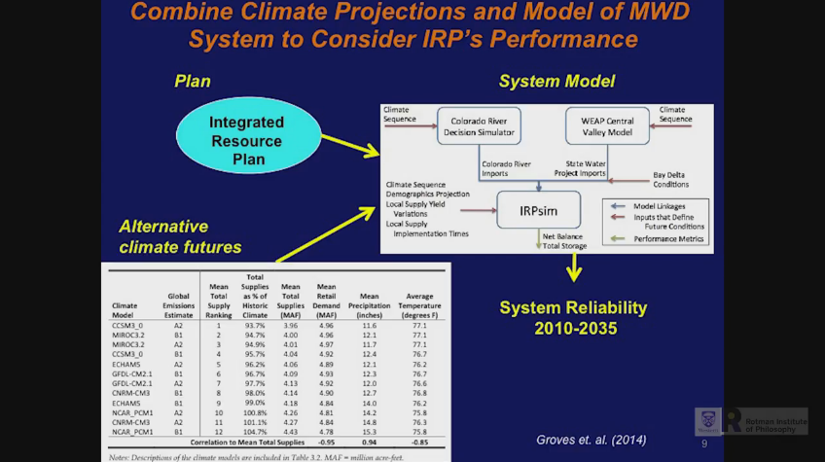
Robert Lempert: Democratizing Analytics: Scientifically and Ethically Informed Decision Support
https://www.youtube.com/watch?v=D01UM0G2m_k

Slide 25
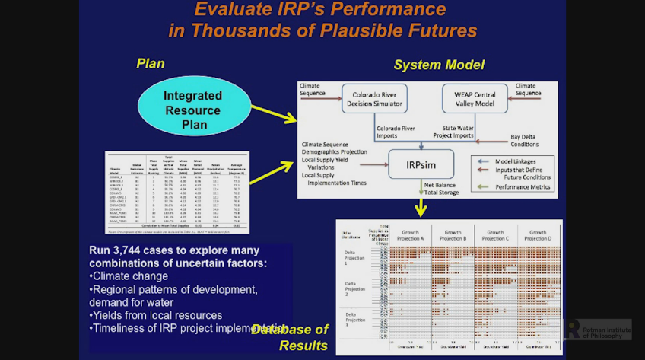
Robert Lempert: Democratizing Analytics: Scientifically and Ethically Informed Decision Support
https://www.youtube.com/watch?v=D01UM0G2m_k

Slide 26
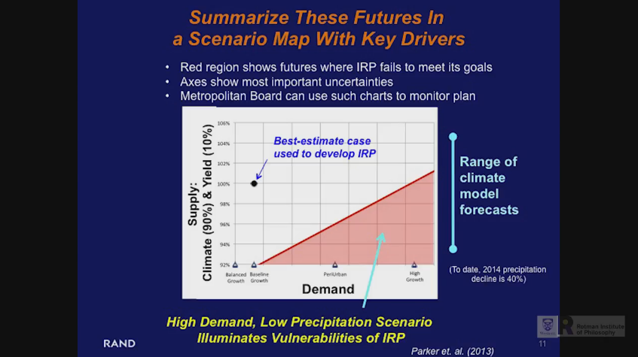
Robert Lempert: Democratizing Analytics: Scientifically and Ethically Informed Decision Support
https://www.youtube.com/watch?v=D01UM0G2m_k

Slide 27
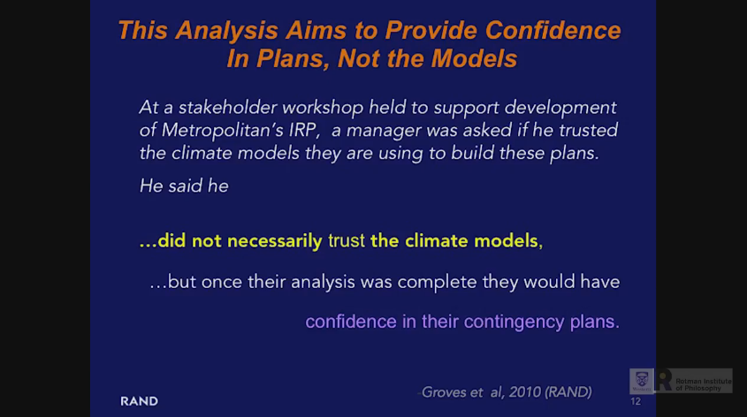
Robert Lempert: Democratizing Analytics: Scientifically and Ethically Informed Decision Support
O Ponto não é ter mais confiança nos modelos e sim mais confiança nas estratégias / planos de contingência!!!
https://www.youtube.com/watch?v=D01UM0G2m_k

Slide 28
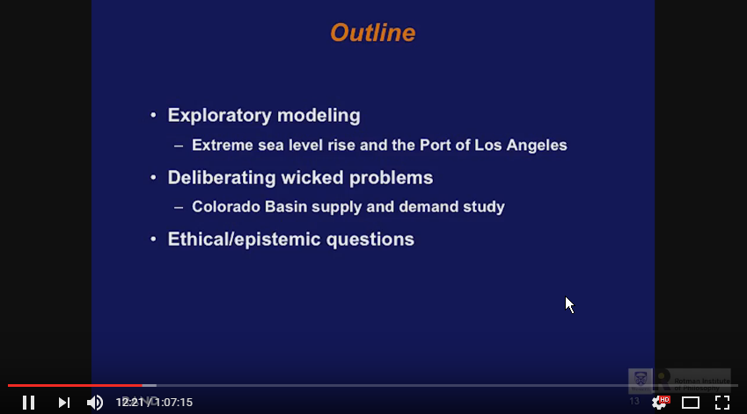
Robert Lempert: Democratizing Analytics: Scientifically and Ethically Informed Decision Support
https://www.youtube.com/watch?v=D01UM0G2m_k

Slide 29
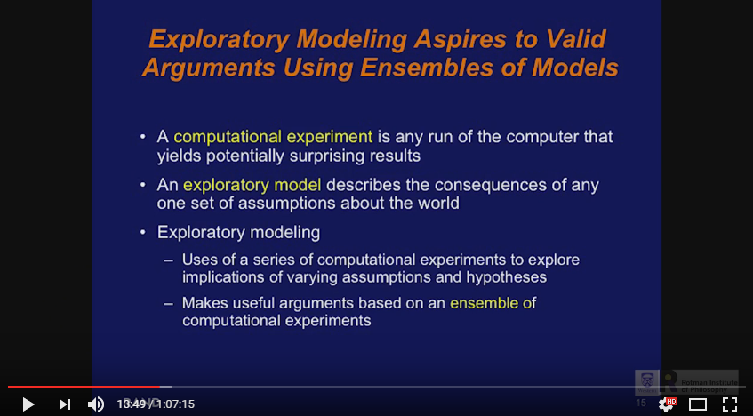
Robert Lempert: Democratizing Analytics: Scientifically and Ethically Informed Decision Support
https://www.youtube.com/watch?v=D01UM0G2m_k

Slide 30
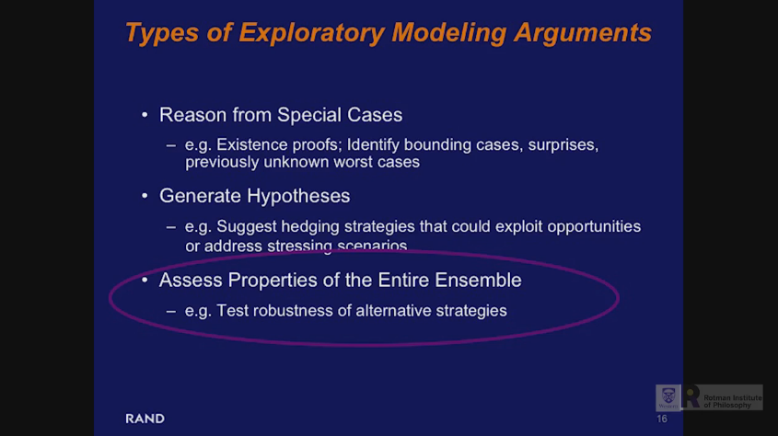
Robert Lempert: Democratizing Analytics: Scientifically and Ethically Informed Decision Support
https://www.youtube.com/watch?v=D01UM0G2m_k

Slide 31
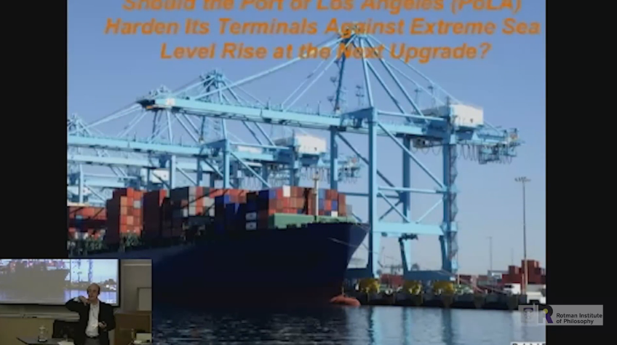
Robert Lempert: Democratizing Analytics: Scientifically and Ethically Informed Decision Support
https://www.youtube.com/watch?v=D01UM0G2m_k

Slide 32
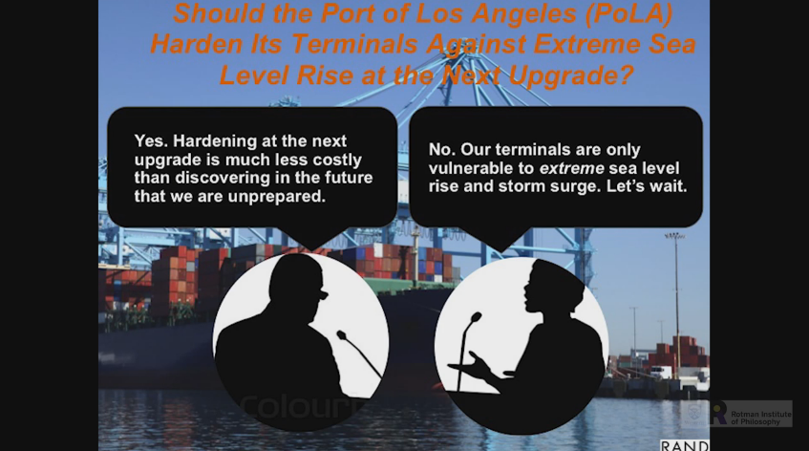
Robert Lempert: Democratizing Analytics: Scientifically and Ethically Informed Decision Support
https://www.youtube.com/watch?v=D01UM0G2m_k

Slide 33
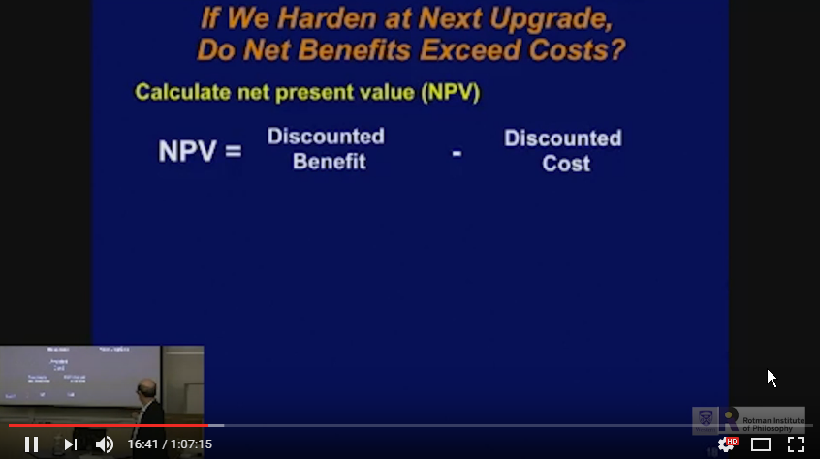
Robert Lempert: Democratizing Analytics: Scientifically and Ethically Informed Decision Support
https://www.youtube.com/watch?v=D01UM0G2m_k

Slide 34
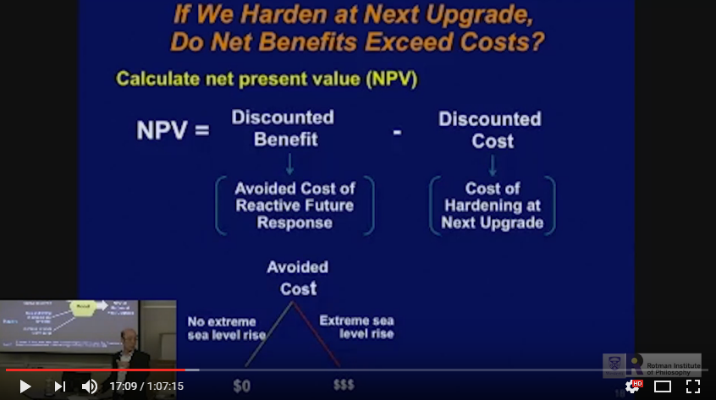
Robert Lempert: Democratizing Analytics: Scientifically and Ethically Informed Decision Support
https://www.youtube.com/watch?v=D01UM0G2m_k

Slide 35
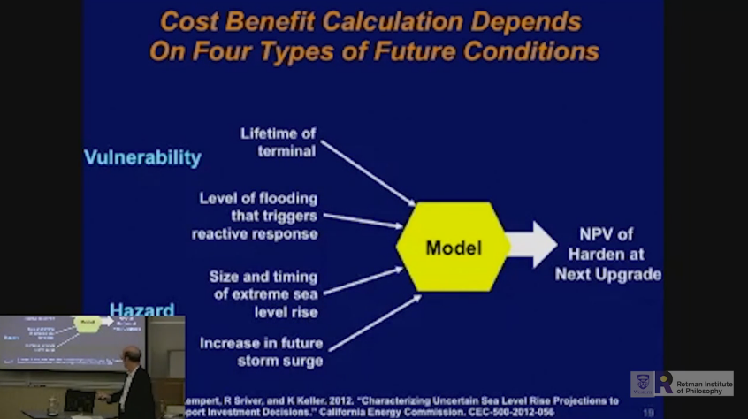
Robert Lempert: Democratizing Analytics: Scientifically and Ethically Informed Decision Support
https://www.youtube.com/watch?v=D01UM0G2m_k

Slide 36
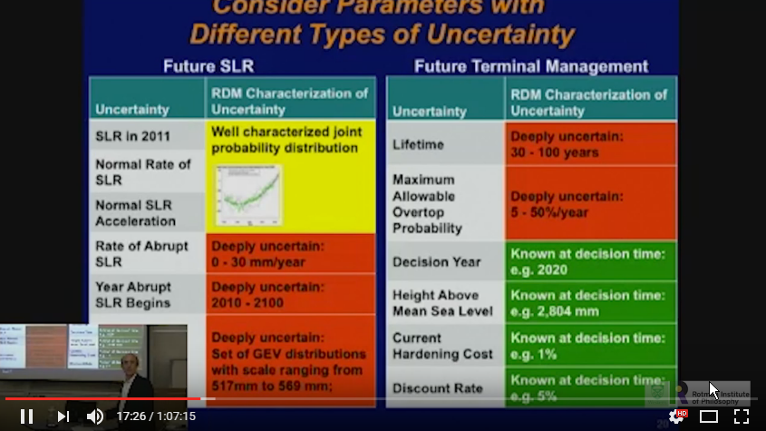
Robert Lempert: Democratizing Analytics: Scientifically and Ethically Informed Decision Support
https://www.youtube.com/watch?v=D01UM0G2m_k

Slide 37
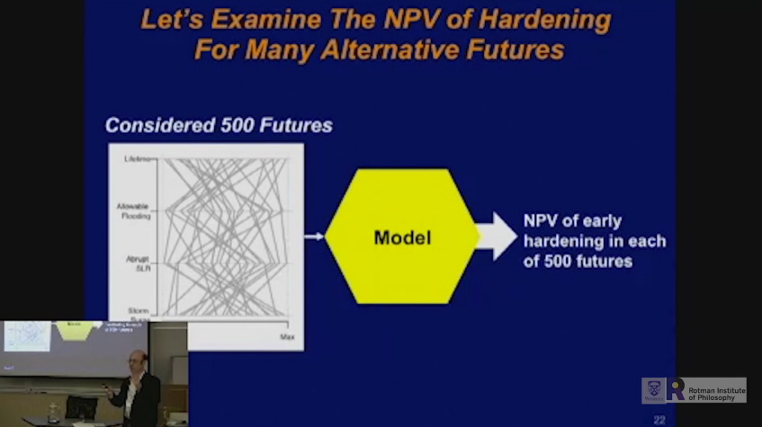
Robert Lempert: Democratizing Analytics: Scientifically and Ethically Informed Decision Support
https://www.youtube.com/watch?v=D01UM0G2m_k

Slide 38
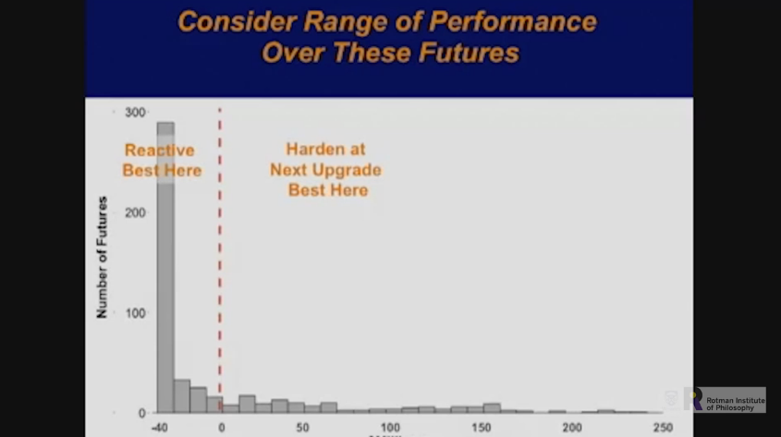
Robert Lempert: Democratizing Analytics: Scientifically and Ethically Informed Decision Support
https://www.youtube.com/watch?v=D01UM0G2m_k

Slide 39
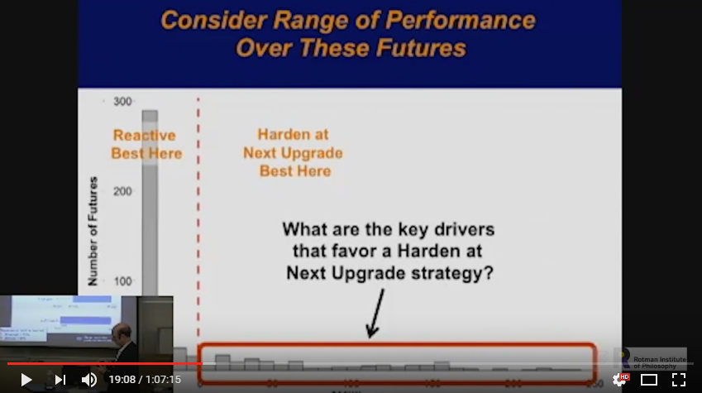
Robert Lempert: Democratizing Analytics: Scientifically and Ethically Informed Decision Support
https://www.youtube.com/watch?v=D01UM0G2m_k

Slide 40
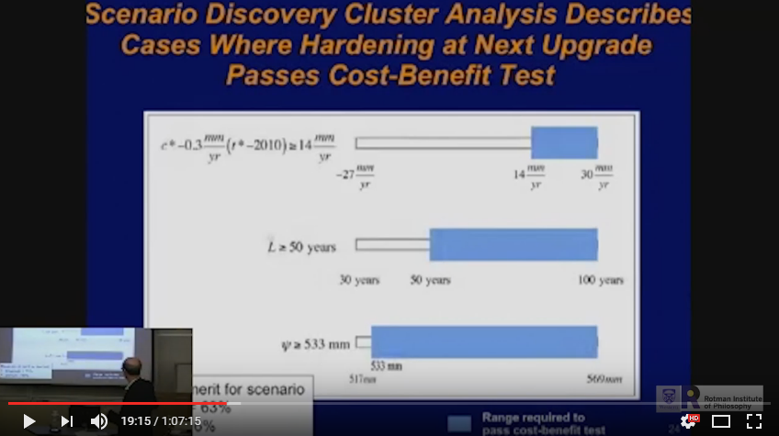
Robert Lempert: Democratizing Analytics: Scientifically and Ethically Informed Decision Support
https://www.youtube.com/watch?v=D01UM0G2m_k

Slide 41
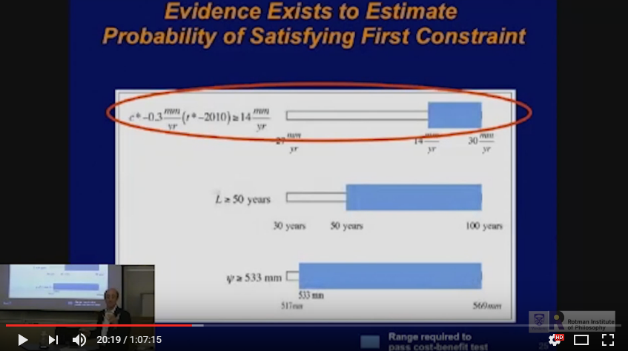
Robert Lempert: Democratizing Analytics: Scientifically and Ethically Informed Decision Support
Depois que ele achou o fator que mais impacta ele vai olhar a probabilidade dele acontecer.
https://www.youtube.com/watch?v=D01UM0G2m_k

Slide 42
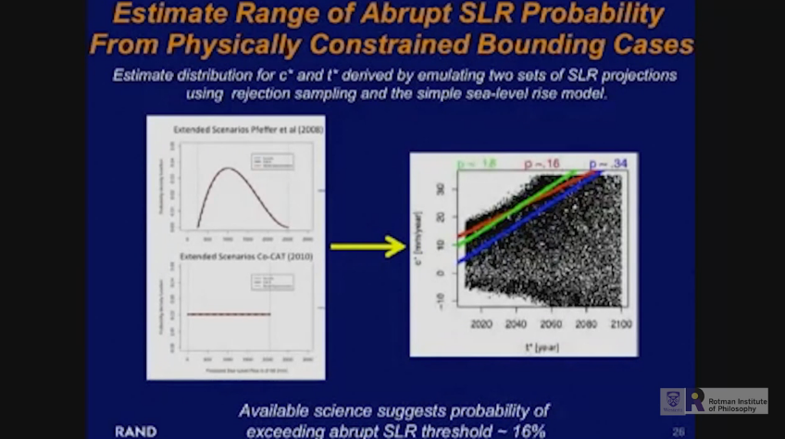
Robert Lempert: Democratizing Analytics: Scientifically and Ethically Informed Decision Support
https://www.youtube.com/watch?v=D01UM0G2m_k

Slide 43
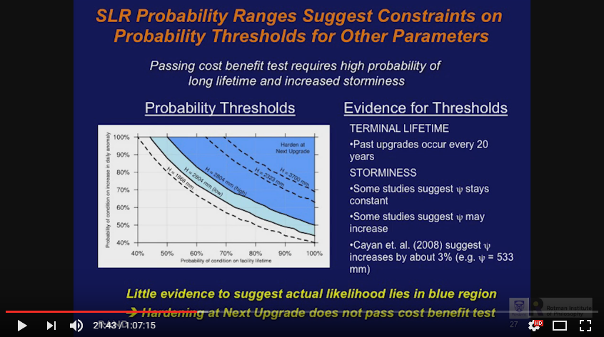
Robert Lempert: Democratizing Analytics: Scientifically and Ethically Informed Decision Support
https://www.youtube.com/watch?v=D01UM0G2m_k

Slide 44
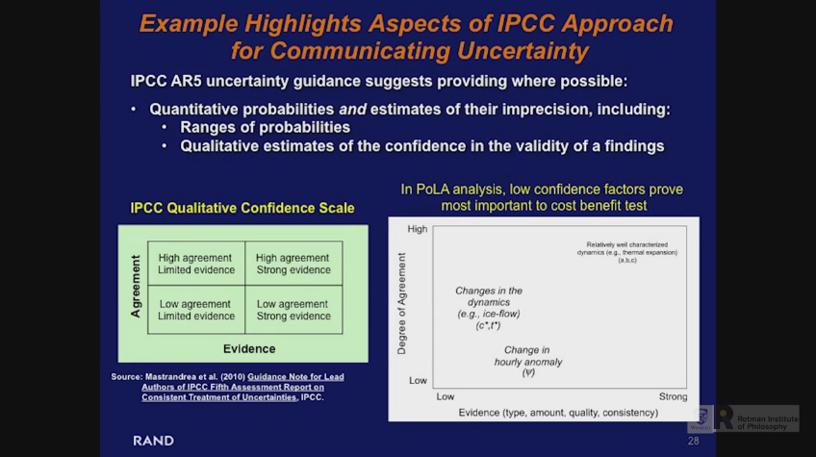
Robert Lempert: Democratizing Analytics: Scientifically and Ethically Informed Decision Support
https://www.youtube.com/watch?v=D01UM0G2m_k

Slide 45
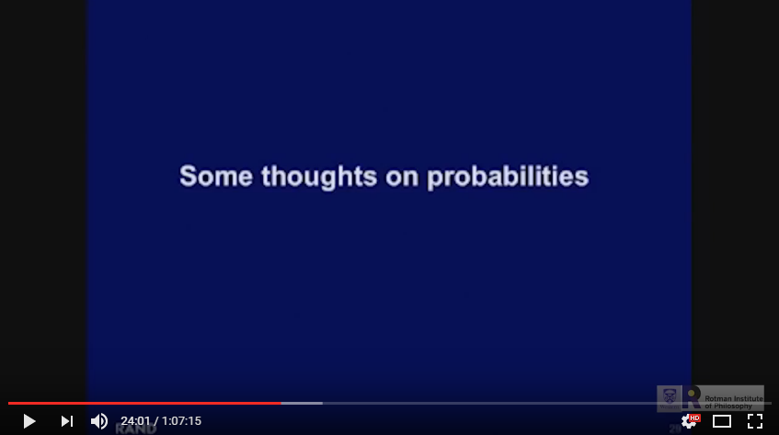
Robert Lempert: Democratizing Analytics: Scientifically and Ethically Informed Decision Support
https://www.youtube.com/watch?v=D01UM0G2m_k

Slide 46
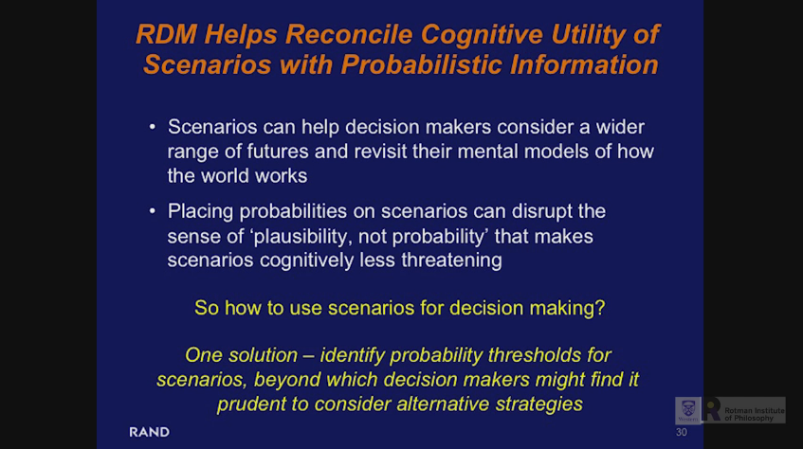
Robert Lempert: Democratizing Analytics: Scientifically and Ethically Informed Decision Support
https://www.youtube.com/watch?v=D01UM0G2m_k

Slide 47
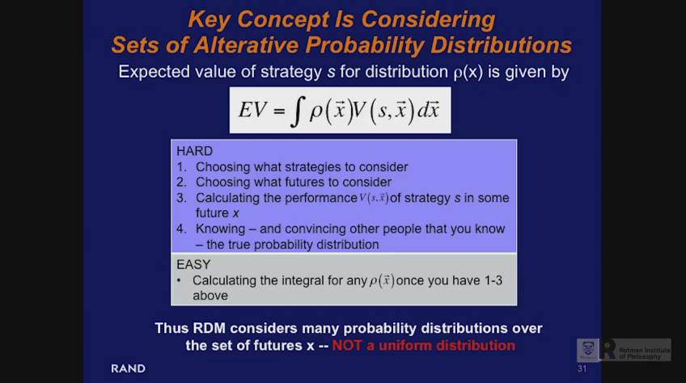
Robert Lempert: Democratizing Analytics: Scientifically and Ethically Informed Decision Support
https://www.youtube.com/watch?v=D01UM0G2m_k

Slide 48
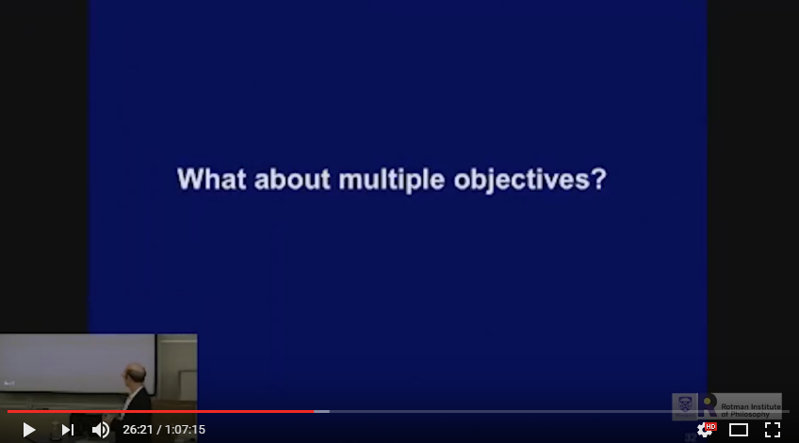
Robert Lempert: Democratizing Analytics: Scientifically and Ethically Informed Decision Support
https://www.youtube.com/watch?v=D01UM0G2m_k

Slide 49
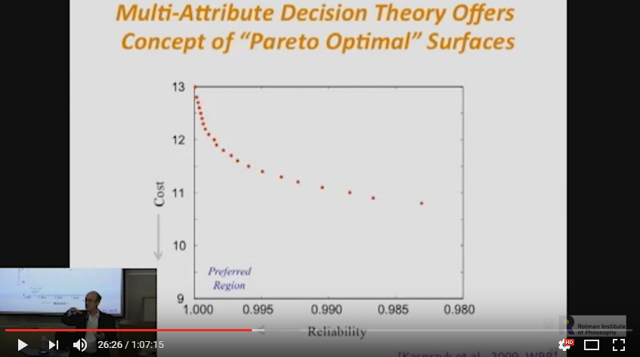
Robert Lempert: Democratizing Analytics: Scientifically and Ethically Informed Decision Support
https://www.youtube.com/watch?v=D01UM0G2m_k

Slide 50
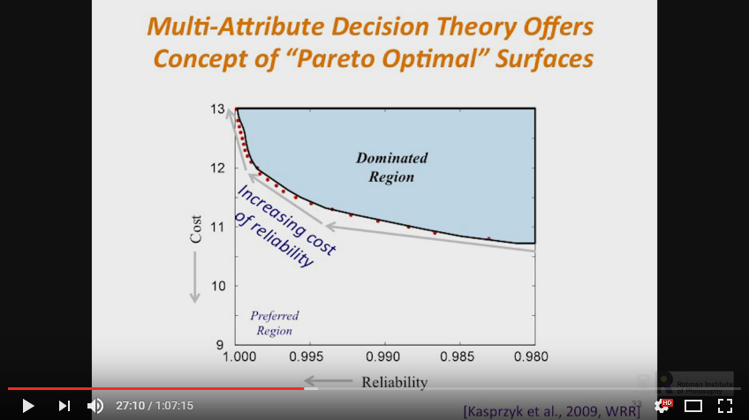
Robert Lempert: Democratizing Analytics: Scientifically and Ethically Informed Decision Support
https://www.youtube.com/watch?v=D01UM0G2m_k

Slide 51
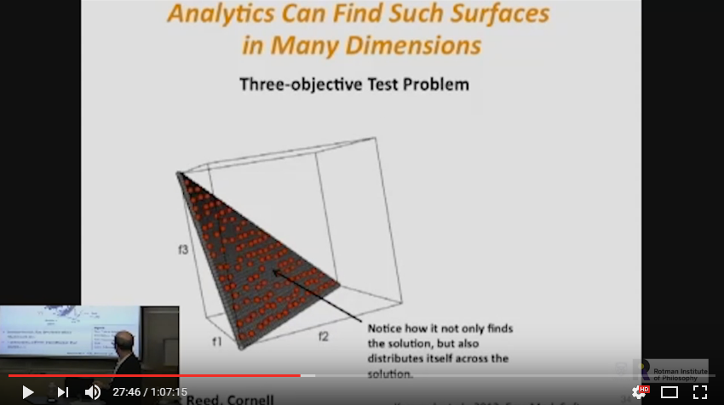
Robert Lempert: Democratizing Analytics: Scientifically and Ethically Informed Decision Support
https://www.youtube.com/watch?v=D01UM0G2m_k

Slide 52

Robert Lempert: Democratizing Analytics: Scientifically and Ethically Informed Decision Support
https://www.youtube.com/watch?v=D01UM0G2m_k

Slide 53

Robert Lempert: Democratizing Analytics: Scientifically and Ethically Informed Decision Support
https://www.youtube.com/watch?v=D01UM0G2m_k

Slide 54

Robert Lempert: Democratizing Analytics: Scientifically and Ethically Informed Decision Support
https://www.youtube.com/watch?v=D01UM0G2m_k

Slide 55

Robert Lempert: Democratizing Analytics: Scientifically and Ethically Informed Decision Support
https://www.youtube.com/watch?v=D01UM0G2m_k

Slide 56

Robert Lempert: Democratizing Analytics: Scientifically and Ethically Informed Decision Support
https://www.youtube.com/watch?v=D01UM0G2m_k

Slide 57

Robert Lempert: Democratizing Analytics: Scientifically and Ethically Informed Decision Support
https://www.youtube.com/watch?v=D01UM0G2m_k

Slide 58

Robert Lempert: Democratizing Analytics: Scientifically and Ethically Informed Decision Support
https://www.youtube.com/watch?v=D01UM0G2m_k

Slide 59

Robert Lempert: Democratizing Analytics: Scientifically and Ethically Informed Decision Support
https://www.youtube.com/watch?v=D01UM0G2m_k

Slide 60

Robert Lempert: Democratizing Analytics: Scientifically and Ethically Informed Decision Support
https://www.youtube.com/watch?v=D01UM0G2m_k

Slide 61

Robert Lempert: Democratizing Analytics: Scientifically and Ethically Informed Decision Support
https://www.youtube.com/watch?v=D01UM0G2m_k

Slide 62

Robert Lempert: Democratizing Analytics: Scientifically and Ethically Informed Decision Support
https://www.youtube.com/watch?v=D01UM0G2m_k

Slide 63

Robert Lempert: Democratizing Analytics: Scientifically and Ethically Informed Decision Support
https://www.youtube.com/watch?v=D01UM0G2m_k

Slide 64

Robert Lempert: Democratizing Analytics: Scientifically and Ethically Informed Decision Support
https://www.youtube.com/watch?v=D01UM0G2m_k

Slide 65

Robert Lempert: Democratizing Analytics: Scientifically and Ethically Informed Decision Support
https://www.youtube.com/watch?v=D01UM0G2m_k

Slide 66

Robert Lempert: Democratizing Analytics: Scientifically and Ethically Informed Decision Support
https://www.youtube.com/watch?v=D01UM0G2m_k

Slide 67

Robert Lempert: Democratizing Analytics: Scientifically and Ethically Informed Decision Support
https://www.youtube.com/watch?v=D01UM0G2m_k

Slide 68

Robert Lempert: Democratizing Analytics: Scientifically and Ethically Informed Decision Support
https://www.youtube.com/watch?v=D01UM0G2m_k

Slide 69

Robert Lempert: Democratizing Analytics: Scientifically and Ethically Informed Decision Support
https://www.youtube.com/watch?v=D01UM0G2m_k

Slide 70

Robert Lempert: Democratizing Analytics: Scientifically and Ethically Informed Decision Support
https://www.youtube.com/watch?v=D01UM0G2m_k

Slide 71

Robert Lempert: Democratizing Analytics: Scientifically and Ethically Informed Decision Support
https://www.youtube.com/watch?v=D01UM0G2m_k

Slide 72

Robert Lempert: Democratizing Analytics: Scientifically and Ethically Informed Decision Support
https://www.youtube.com/watch?v=D01UM0G2m_k

Slide 73

Robert Lempert: Democratizing Analytics: Scientifically and Ethically Informed Decision Support
https://www.youtube.com/watch?v=D01UM0G2m_k

Slide 74

Robert Lempert: Democratizing Analytics: Scientifically and Ethically Informed Decision Support
https://www.youtube.com/watch?v=D01UM0G2m_k

Slide 75

Robert Lempert: Democratizing Analytics: Scientifically and Ethically Informed Decision Support
https://www.youtube.com/watch?v=D01UM0G2m_k

Slide 76

Robert Lempert: Democratizing Analytics: Scientifically and Ethically Informed Decision Support
https://www.youtube.com/watch?v=D01UM0G2m_k

Slide 77

Robert Lempert: Democratizing Analytics: Scientifically and Ethically Informed Decision Support
https://www.youtube.com/watch?v=D01UM0G2m_k

Slide 78

Robert Lempert: Democratizing Analytics: Scientifically and Ethically Informed Decision Support
https://www.youtube.com/watch?v=D01UM0G2m_k

Slide 79
Robert Lempert: Democratizing Analytics: Scientifically and Ethically Informed Decision Support
Q: Se o modelo não pode ser validado, como é que ele pode ser usado para gerar os cenários e gerar os números?
R: No contexto, há um modelo que funciona, e que relaciona as causas com as consequência. E o modelo é útil porque você não consegue fazerna cabeça.
Multiplos Objetivos: Se tem muitos objetivos podem ter menos estratégias boas, e talvez mais tradeoffs.
Thresholds e Probabilidades: “Case”: Uma estratégia em um futuro. Cenário: Grupo de futuros que compartilham características. Como se chega a cenários: Rodar o modelo varias vezes, especificar critério para enquadrar no cenário e rodar análise de clusters. Mesmo sem probabilidade o cenário pode ser útil.
Mesmo sem probabilidade o cenário pode ser interessante para identificar vulnerabilidades.
As probabilidades são importantes para avaliar tradeoffs. O threshold não é uma propriedade do futuro, é uma propriedade da estratégia. “Se você é neutro ao risco, dados os custos assumidos, aquele cenário”. Se há 7% de probabilidade daqueles cenários acontecerem. Dúvida: Entender os thresholds.

Slide 80

Método para “Response Option Analysis”
https://www.youtube.com/watch?v=CuETbrNg3S0

Slide 81

Método para “Response Option Analysis”
https://www.youtube.com/watch?v=CuETbrNg3S0

Slide 82

Método para “Response Option Analysis”
https://www.youtube.com/watch?v=CuETbrNg3S0

Slide 83

Método para “Response Option Analysis”
https://www.youtube.com/watch?v=CuETbrNg3S0

Slide 84

Método para “Response Option Analysis”
https://www.youtube.com/watch?v=CuETbrNg3S0

Slide 85

Método para “Response Option Analysis”
https://www.youtube.com/watch?v=CuETbrNg3S0

Slide 86

Método para “Response Option Analysis”
https://www.youtube.com/watch?v=CuETbrNg3S0

Slide 87

Método para “Response Option Analysis”
https://www.youtube.com/watch?v=CuETbrNg3S0

Slide 88

Método para “Response Option Analysis”
https://www.youtube.com/watch?v=CuETbrNg3S0

Slide 89

Método para “Response Option Analysis”
https://www.youtube.com/watch?v=CuETbrNg3S0

Slide 90

Método para “Response Option Analysis”
https://www.youtube.com/watch?v=CuETbrNg3S0

Slide 91

Método para “Response Option Analysis”
https://www.youtube.com/watch?v=CuETbrNg3S0

Slide 92

Método para “Response Option Analysis”
https://www.youtube.com/watch?v=CuETbrNg3S0

Slide 93

Método para “Response Option Analysis”
https://www.youtube.com/watch?v=CuETbrNg3S0

Slide 94

Método para “Response Option Analysis”
https://www.youtube.com/watch?v=CuETbrNg3S0

Slide 95

Método para “Response Option Analysis”
https://www.youtube.com/watch?v=CuETbrNg3S0

Slide 96

Método para “Response Option Analysis”
https://www.youtube.com/watch?v=CuETbrNg3S0

Slide 97

Método para “Response Option Analysis”
https://www.youtube.com/watch?v=CuETbrNg3S0

Slide 98

Método para “Response Option Analysis”
https://www.youtube.com/watch?v=CuETbrNg3S0

Slide 99
Método para “Response Option Analysis”
https://www.youtube.com/watch?v=CuETbrNg3S0

Slide 100

Método para “Response Option Analysis”
https://www.youtube.com/watch?v=CuETbrNg3S0

Slide 101

Método para “Response Option Analysis”
https://www.youtube.com/watch?v=CuETbrNg3S0

Slide 102

Método para “Response Option Analysis”
https://www.youtube.com/watch?v=CuETbrNg3S0

Slide 103

Método para “Response Option Analysis”
https://www.youtube.com/watch?v=CuETbrNg3S0

Slide 104

Método para “Response Option Analysis”
https://www.youtube.com/watch?v=CuETbrNg3S0

Slide 105

Método para “Response Option Analysis”
https://www.youtube.com/watch?v=CuETbrNg3S0

Slide 106

Método para “Response Option Analysis”
https://www.youtube.com/watch?v=CuETbrNg3S0

Slide 107

Método para “Response Option Analysis”
https://www.youtube.com/watch?v=CuETbrNg3S0

Slide 108
Método para “Response Option Analysis”
https://www.youtube.com/watch?v=CuETbrNg3S0

Slide 109

Método para “Response Option Analysis”
https://www.youtube.com/watch?v=CuETbrNg3S0

Slide 110

Método para “Response Option Analysis”
A análise chegou à conclusão que a política de seguros dos estados unidos contra ataques terroristas seria ruim (ou seja, chegou à uma conclusão contrária à situação anterior).
https://www.youtube.com/watch?v=CuETbrNg3S0

Slide 111

Método para “Response Option Analysis”
https://www.youtube.com/watch?v=CuETbrNg3S0

Slide 112

Método para “Response Option Analysis”
https://www.youtube.com/watch?v=CuETbrNg3S0

Slide 113

Método para “Response Option Analysis”
https://www.youtube.com/watch?v=CuETbrNg3S0

Slide 114

Método para “Response Option Analysis”
https://www.youtube.com/watch?v=CuETbrNg3S0

Slide 115

Método para “Response Option Analysis”
https://www.youtube.com/watch?v=CuETbrNg3S0

Slide 116

A New Decision Science for Complex Systems: A Decade of Enabling Tools
https://www.youtube.com/watch?v=a0I4buEvjl4

Slide 117

A New Decision Science for Complex Systems: A Decade of Enabling Tools
https://www.youtube.com/watch?v=a0I4buEvjl4

Slide 118

A New Decision Science for Complex Systems: A Decade of Enabling Tools
https://www.youtube.com/watch?v=a0I4buEvjl4

Slide 119

A New Decision Science for Complex Systems: A Decade of Enabling Tools
https://www.youtube.com/watch?v=a0I4buEvjl4

Slide 120

A New Decision Science for Complex Systems: A Decade of Enabling Tools
https://www.youtube.com/watch?v=a0I4buEvjl4

Slide 121

A New Decision Science for Complex Systems: A Decade of Enabling Tools
https://www.youtube.com/watch?v=a0I4buEvjl4

Slide 122

A New Decision Science for Complex Systems: A Decade of Enabling Tools
https://www.youtube.com/watch?v=a0I4buEvjl4

Slide 123

A New Decision Science for Complex Systems: A Decade of Enabling Tools
https://www.youtube.com/watch?v=a0I4buEvjl4

Slide 124

A New Decision Science for Complex Systems: A Decade of Enabling Tools
https://www.youtube.com/watch?v=a0I4buEvjl4

Slide 125

A New Decision Science for Complex Systems: A Decade of Enabling Tools
https://www.youtube.com/watch?v=a0I4buEvjl4

Slide 126

A New Decision Science for Complex Systems: A Decade of Enabling Tools
https://www.youtube.com/watch?v=a0I4buEvjl4

Slide 127

A New Decision Science for Complex Systems: A Decade of Enabling Tools
https://www.youtube.com/watch?v=a0I4buEvjl4

Slide 128

A New Decision Science for Complex Systems: A Decade of Enabling Tools
https://www.youtube.com/watch?v=a0I4buEvjl4

Slide 129

A New Decision Science for Complex Systems: A Decade of Enabling Tools
https://www.youtube.com/watch?v=a0I4buEvjl4

Slide 130

A New Decision Science for Complex Systems: A Decade of Enabling Tools
https://www.youtube.com/watch?v=a0I4buEvjl4

Slide 131

A New Decision Science for Complex Systems: A Decade of Enabling Tools
https://www.youtube.com/watch?v=a0I4buEvjl4

Slide 132

A New Decision Science for Complex Systems: A Decade of Enabling Tools
https://www.youtube.com/watch?v=a0I4buEvjl4

Slide 133

A New Decision Science for Complex Systems: A Decade of Enabling Tools
https://www.youtube.com/watch?v=a0I4buEvjl4

Slide 134

A New Decision Science for Complex Systems: A Decade of Enabling Tools
https://www.youtube.com/watch?v=a0I4buEvjl4

Slide 135

A New Decision Science for Complex Systems: A Decade of Enabling Tools
https://www.youtube.com/watch?v=a0I4buEvjl4

Slide 136

A New Decision Science for Complex Systems: A Decade of Enabling Tools
https://www.youtube.com/watch?v=a0I4buEvjl4

Slide 137

A New Decision Science for Complex Systems: A Decade of Enabling Tools
https://www.youtube.com/watch?v=a0I4buEvjl4

Slide 138

A New Decision Science for Complex Systems: A Decade of Enabling Tools
https://www.youtube.com/watch?v=a0I4buEvjl4

Slide 139

A New Decision Science for Complex Systems: A Decade of Enabling Tools
https://www.youtube.com/watch?v=a0I4buEvjl4

Slide 140

A New Decision Science for Complex Systems: A Decade of Enabling Tools
https://www.youtube.com/watch?v=a0I4buEvjl4

Slide 141

A New Decision Science for Complex Systems: A Decade of Enabling Tools
https://www.youtube.com/watch?v=a0I4buEvjl4

Slide 142

A New Decision Science for Complex Systems: A Decade of Enabling Tools
https://www.youtube.com/watch?v=a0I4buEvjl4

Slide 143

A New Decision Science for Complex Systems: A Decade of Enabling Tools
https://www.youtube.com/watch?v=a0I4buEvjl4

Slide 144

A New Decision Science for Complex Systems: A Decade of Enabling Tools
https://www.youtube.com/watch?v=a0I4buEvjl4

Slide 145

A New Decision Science for Complex Systems: A Decade of Enabling Tools
https://www.youtube.com/watch?v=a0I4buEvjl4

Slide 146

A New Decision Science for Complex Systems: A Decade of Enabling Tools
https://www.youtube.com/watch?v=a0I4buEvjl4

Slide 147

Impacts of Climate Change on African Water Infrastructure Performance
https://www.youtube.com/watch?v=PUmsCu-9upk

Slide 148

Impacts of Climate Change on African Water Infrastructure Performance
https://www.youtube.com/watch?v=PUmsCu-9upk

Slide 149

Impacts of Climate Change on African Water Infrastructure Performance
https://www.youtube.com/watch?v=PUmsCu-9upk

Slide 150

Impacts of Climate Change on African Water Infrastructure Performance
https://www.youtube.com/watch?v=PUmsCu-9upk

Slide 151

Impacts of Climate Change on African Water Infrastructure Performance
https://www.youtube.com/watch?v=PUmsCu-9upk

Slide 152

Impacts of Climate Change on African Water Infrastructure Performance
https://www.youtube.com/watch?v=PUmsCu-9upk

Slide 153

Impacts of Climate Change on African Water Infrastructure Performance
https://www.youtube.com/watch?v=PUmsCu-9upk

Slide 154

Impacts of Climate Change on African Water Infrastructure Performance
https://www.youtube.com/watch?v=PUmsCu-9upk

Slide 155

Impacts of Climate Change on African Water Infrastructure Performance
https://www.youtube.com/watch?v=PUmsCu-9upk

Slide 156

Impacts of Climate Change on African Water Infrastructure Performance
https://www.youtube.com/watch?v=PUmsCu-9upk

Slide 157

Impacts of Climate Change on African Water Infrastructure Performance
https://www.youtube.com/watch?v=PUmsCu-9upk

Slide 158

Impacts of Climate Change on African Water Infrastructure Performance
https://www.youtube.com/watch?v=PUmsCu-9upk

Slide 159

Impacts of Climate Change on African Water Infrastructure Performance
https://www.youtube.com/watch?v=PUmsCu-9upk

Slide 160

Impacts of Climate Change on African Water Infrastructure Performance
https://www.youtube.com/watch?v=PUmsCu-9upk

Slide 161

Impacts of Climate Change on African Water Infrastructure Performance
https://www.youtube.com/watch?v=PUmsCu-9upk

Slide 162
Impacts of Climate Change on African Water Infrastructure Performance
https://www.youtube.com/watch?v=PUmsCu-9upk

Slide 163
Impacts of Climate Change on African Water Infrastructure Performance
https://www.youtube.com/watch?v=PUmsCu-9upk

Slide 164
Impacts of Climate Change on African Water Infrastructure Performance
https://www.youtube.com/watch?v=PUmsCu-9upk

Slide 165
Impacts of Climate Change on African Water Infrastructure Performance
https://www.youtube.com/watch?v=PUmsCu-9upk

Slide 166
Impacts of Climate Change on African Water Infrastructure Performance
https://www.youtube.com/watch?v=PUmsCu-9upk

